Slide 1
Adaptive Optimization via Random Projections
Tim Clough

Slide 2
2nd Order Information
Using 2nd order information is desirable
Curvature information gives better steps than GD
Would like to use Newton step
Storing Hessian
Computing updates to Hessian
Computing inverse

Slide 3
Quasi-Newton Alternatives
Direct approximation
BFGS
L-BFGS
Line search can be expensive
Adaptive methods
Momentum
AdaGrad
ADAM, RMSprop

Slide 4
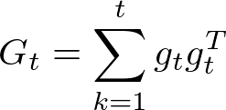

AdaGrad Update
Duchi et al. introduce AdaGrad update
𝛿 term for numerical stability
Computationally cheap
Easy to store
Easy to compute inverse square root
Works well in some settings

Slide 5


Shortcomings of AdaGrad
Consider non-diagonal entries:
Stores covariance of two gradient components
Consider when components are mean-zero:
AdaGrad works well when gradient components are uncorrelated
Won’t work well in convolutional layers, for example
Cannot throw out non-diagonal information otherwise!
In practice, learning rate will decay too quickly

Slide 6

AdaFull
AdaGrad approximates AdaFull
The update is of the form
Full matrix can properly assign “blame”
Regret of AdaFull can scale better than AdaGrad
Regret is a measure of suboptimality
E.g. logistic regression on Gaussian data
Requires storage and inverse square root of p✕p matrix
How can we take advantage of non-diagonal information efficiently?

Slide 7
Enter Random Projections
“Scalable Adaptive Stochastic Optimization Using Random Projections” by Krummenacher et al.
Published in NIPS 2016
Attempts to improve upon AdaGrad
Cannot throw out potentially useful information
But cannot use full matrix
Idea: reduce dimensionality of gradient matrix

Slide 8
Random Approximation
Have p✕p matrix; would like a τ✕p matrix
We saw Nyström approximation
Select a subset of the columns; use as approximation
Won’t work if information is not isolated to small subset of columns
Approach of Krunnemacher et al. uses different approach
Originally developed in “Finding Structure in Randomness: Probabilistic Algorithms for Constructing Approximate Matrix Decompositions” by Halko et al.

Slide 9

Randomized Range Finding
Algorithm 4.5 Fast Randomized Range Finder:
Sample random p✕𝜏 SRFT test matrix 𝛺
Form Y = A𝛺 using an FFT
Construct an orthonormal basis Q of Y, e.g. QR = Y
Intuition: sampling 𝜏 vectors from range of A is likely to yield independent set; A𝛺 multiplication can be done efficiently via FFT
In practice, oversample by 5 or 10 to decrease failure probability significantly (𝛺 is p✕(𝜏+5) or p✕(𝜏+10))
The matrix Q approximates A in the sense that

Slide 10
Randomized SVD
Algorithm 5.1 Direct SVD:
Receive the approximate basis Q of A e.g. using algorithm 4.5
Form B = Q^{T}A
Compute SVD of small matrix: W, Σ, V = B
Form the orthonormal matrix U = QW
Fulfills same guarantee as algorithm 4.5:
Project A onto its approximate range to reduce dimensionality

Slide 11
Ada-LR
Idea: maintain full gradient matrix, but to compute inverse square root, compute a randomized SVD using algorithm 5.1
for t = 1...T do
Receive g_{t}=∇f_{t}(β_{t})
G_{t} = G_{t-1}+g_{t}g_{t}^{T}
Project H_{t} = G_{t}Π
QR = H_{t}
B = Q^{T}G_{t}
U, Σ, V = B
β_{t+1} = β_{t} - 𝜂V(Σ^{1/2}+δI)⁻¹V^{T}g_{t}

Slide 12
Ada-LR (cont.)
AdaFull has per-iteration time complexity O(p³), where p is dimensionality of gradient
Infeasible for even medium problems
AdaLR reduces the cost of the inverse square root to O(𝜏p²)
Has regret bound similar to AdaFull
Total cost is Still expensive:
Storing and updating G_{t} O(p²)
Random projection O(p²log𝜏)
Projection onto Q O(𝜏p²)
Quadratic instead of cubic; suitable for medium size problems
Can we do better?

Slide 13
RadaGrad
Best understood as refinement of AdaLR
Replace expensive operations of AdaLR with more efficient analogues
for t = 1...T do
Receive g_{t}=∇f_{t}(β_{t})
Project h_{t}=Πg_{t}
H_{t} = H_{t-1}+g_{t}h_{t}^{T}
QR = qr_update(Q_{t-1}, R_{t-1}g_{t},h_{t})
B = H_{t}^{T}Q
U, Σ, W = B
V = WQ^{T}

Slide 14
RadaGrad (cont.)
𝛾_{t}=𝜂(g_{t} - V V^{T}g_{t})
β_{t+1}=β_{t}-𝜂V(Σ^{1/2} + δI)V^{T} - 𝛾_{t}
Don’t store full G_{t}; store p✕𝜏 approximation
Store Q and R; use rank-1 QR updates
Project H_{t} onto Q instead of G_{t}
Correction term when G_{t} is more than rank τ
Quadratic terms have been replaced with linear ones - O(τ²p)
No regret bound provided

Slide 15
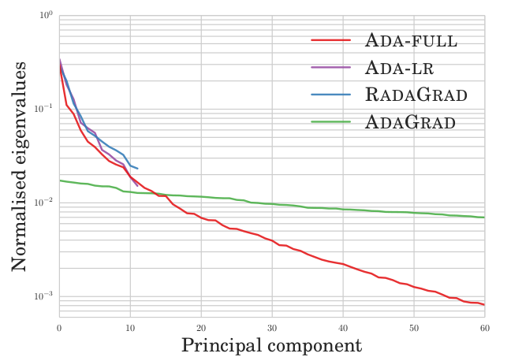
Paper Experiments
Low effective rank data
Randomly generated multivariate Gaussian data
AdaLR and RadaGrad performed close to AdaFull
Singular values of AdaLR and RadaGrad decay quickly
Convolutional Neural Networks
MNIST, CIFAR-10, SVHN
Standard architecture
Only tested RadaGrad and AdaGrad
RadaGrad 5-10x slower per iteration
Faster overall
Could be optimized more?

Slide 16
My Extensions
AdaGrad and AdaLR both have advantages
Can they be combined?
AdaLR+Diag:
𝜈_{D} = (diag(G_{t})^{½}+ 𝛿I)⁻¹g_{t}
𝜈_{R} = V(𝛴^{1/2} + 𝛿I)⁻¹V^{T}g_{t}
β_{t+1} = β_{t} - 𝜂(𝜈_{D} + 𝜈_{R})
Adapt the ideas of ADAM/RMSprop to RadaGrad
RadaForget gradient matrix update: G_{t} = 𝛼G_{t - 1}+ (1 - 𝛼)g_{t}h_{t}^{T}
𝛼 is hyperparameter controlling forgetting rate

Slide 17
Testing Methodology
Used scikit-learn’s make_classification function for binary classification
Samples points from different multivariate normal distributions
Tested with 250 dimensions and 500 dimensions
Trained logistic regression models on each algorithm: AdaFull, AdaGrad, AdaLR, RadaGrad, AdaLR+Diag, RadaForget
Grid searched over choices of 𝜂, 𝜏, and 𝛼 for RadaForget

Slide 18
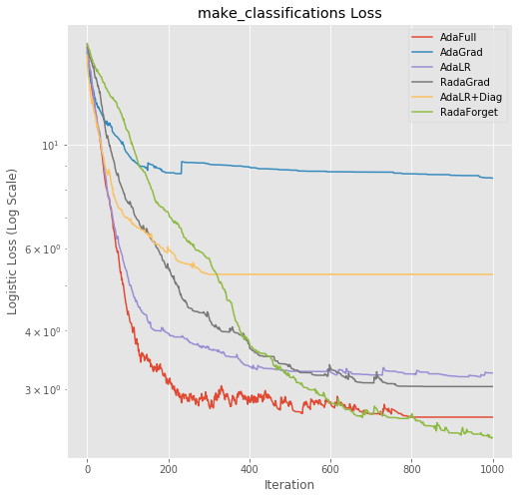
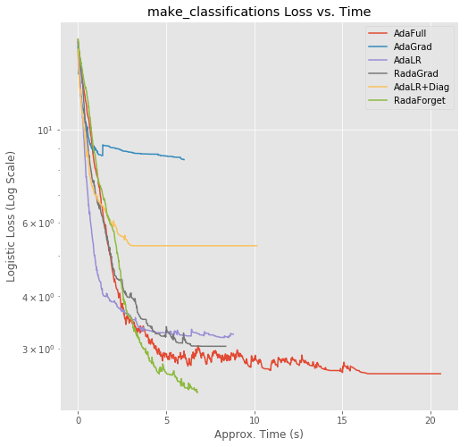
Loss, p = 250

Slide 19
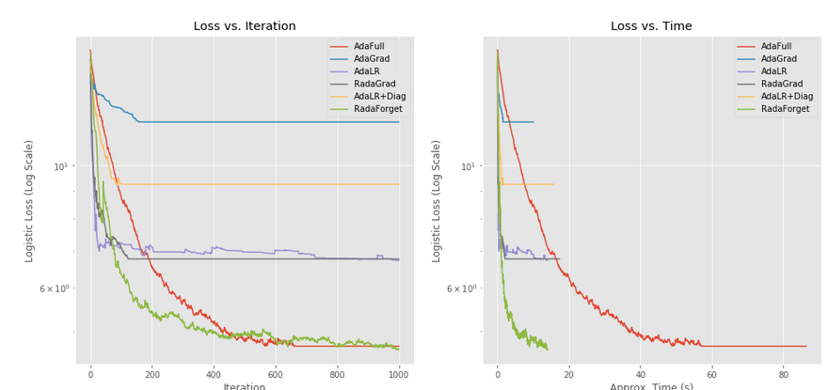
Loss, p = 500

Slide 20
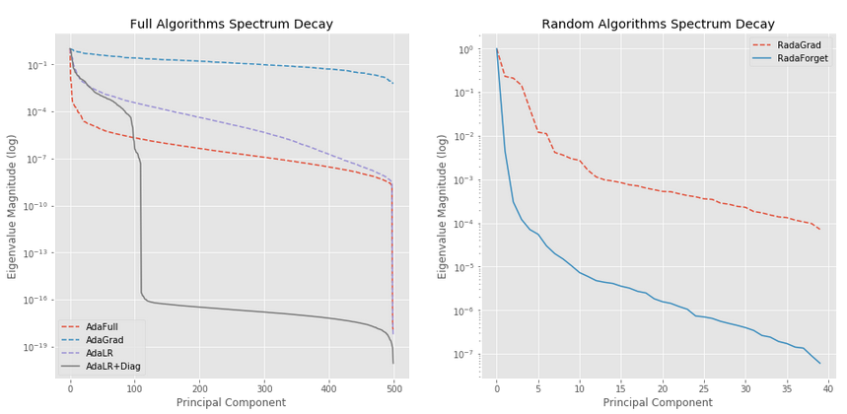
Spectrum Decay, p = 500

Slide 21
Conclusion
AdaLR/RadaGrad are not silver bullets
Work well when data is dense but low-rank
No theoretical guarantees for RadaGrad
Works well in practice
RadaGrad works well with variance reduction
AdaLR+Diag underperforms
Subspace tracking updates could work well
AdaGrad is correction update 𝛾_{t} = 𝜂(diag(G_{t})^{½} + 𝛿I)⁻¹(g_{t} - V V^{T}g_{t})
Exponential forgetting works well on smaller datasets
Authors claim it degrades performance; did not test on neural nets myself
Values of 𝛼 as low as 0.5 work well

